Slide 1
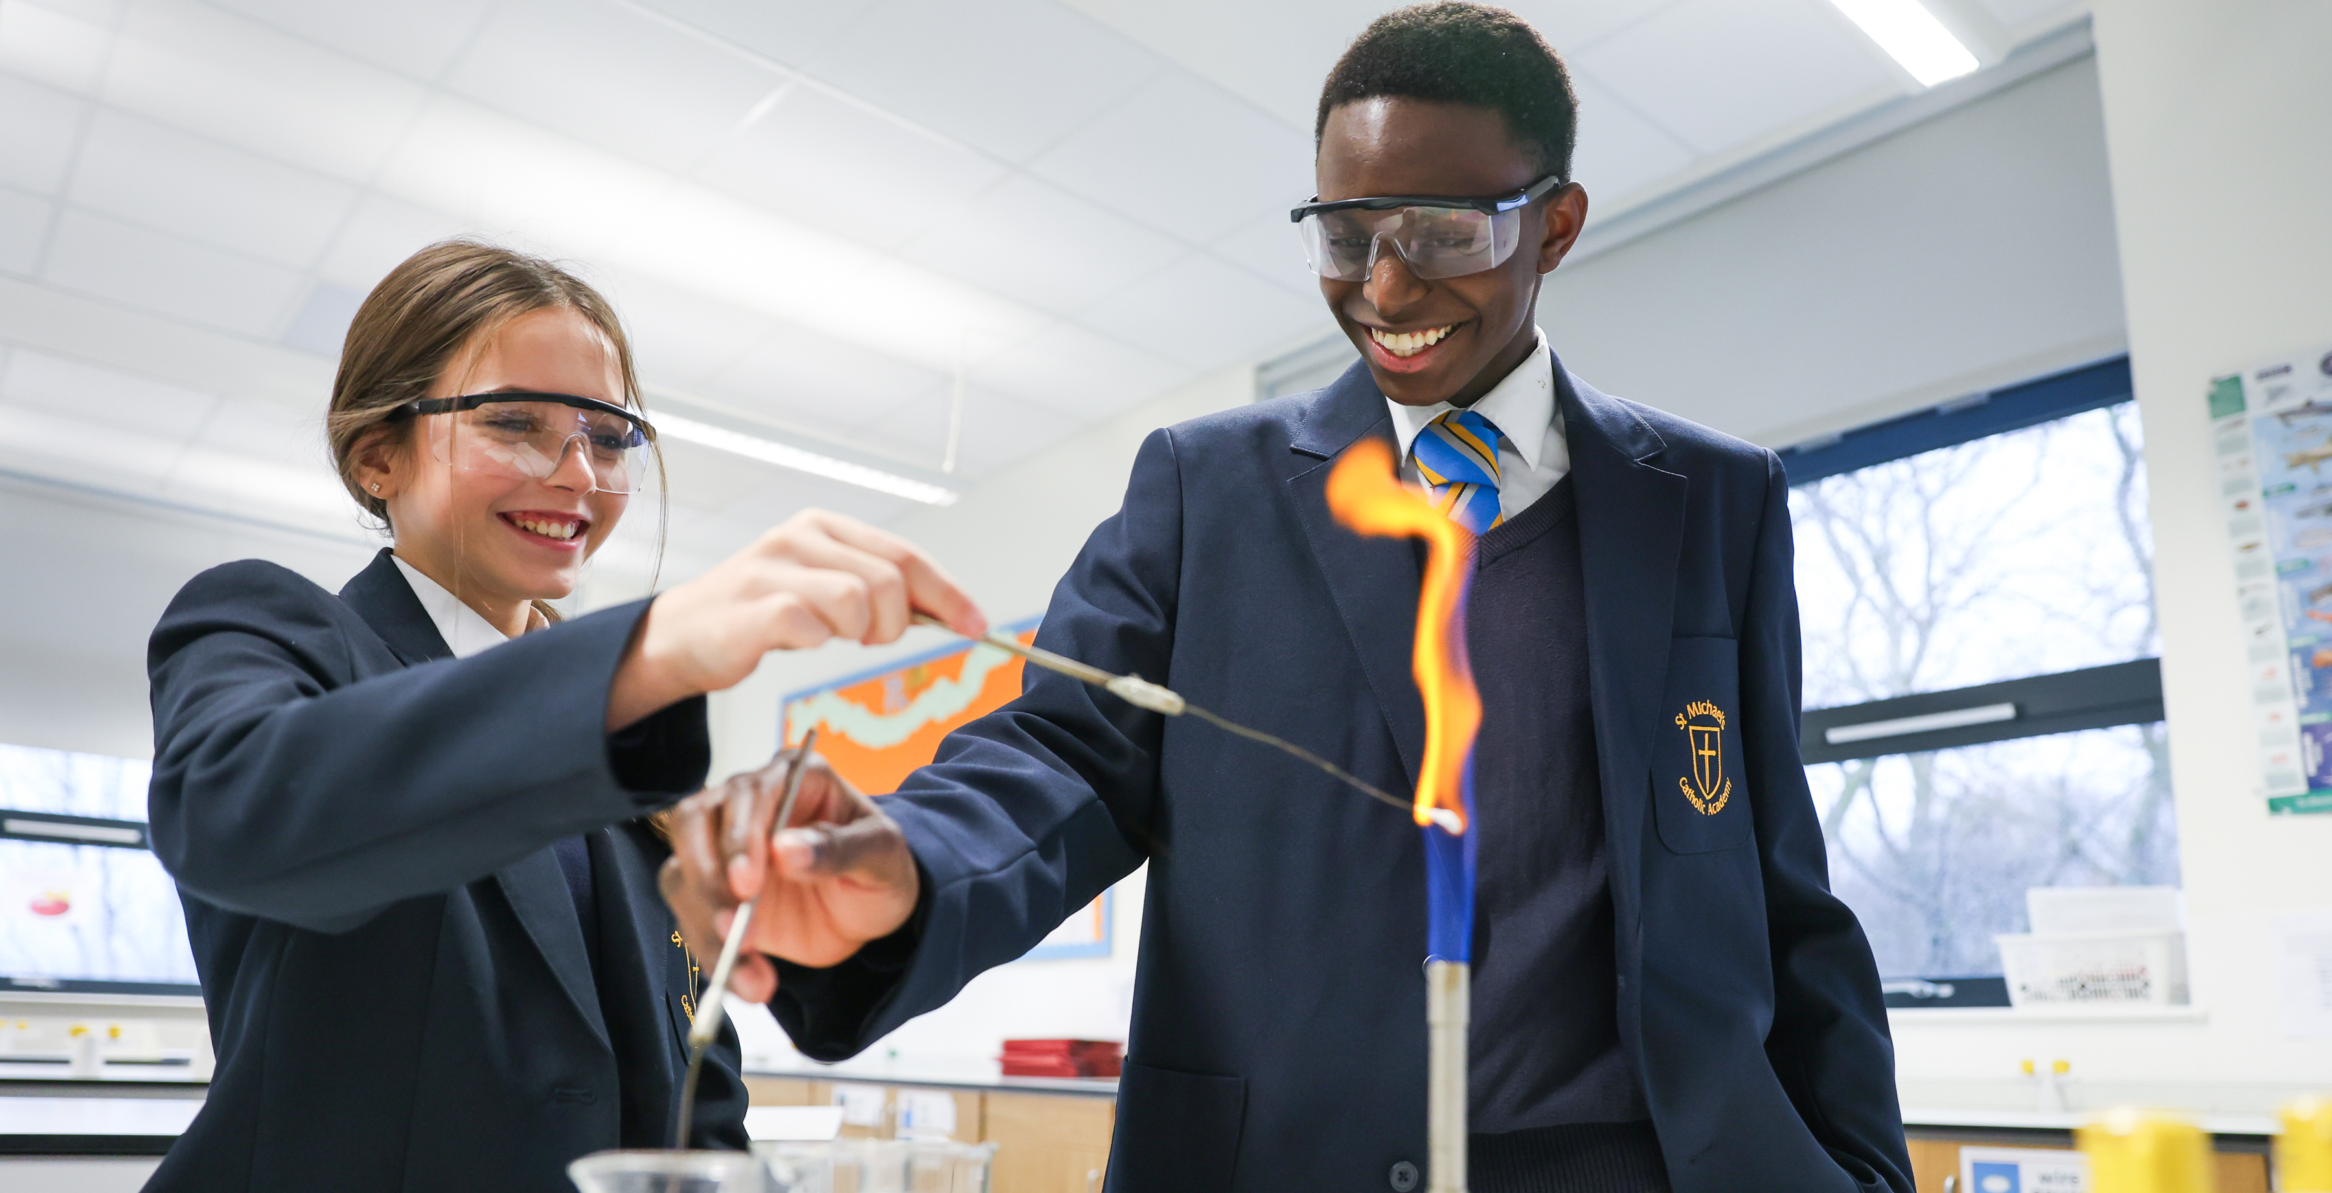
COVER SUPERVISOR
Cover Supervisor
Grade H SCP 14-17
£24,729 - £26,558 pro rata
(FTE £28,729 -£30,061)
37 hours per week
Term time plus 5 days
Permanent: To start as soon as possible
Closing Date: Wednesday 15th January 2025 at 5.00pm
St Michael’s Catholic Academy is a warmly welcoming and inclusive community with a determination to achieve the highest standards. We seek a passionate and committed Cover Supervisor.
The successful applicant will have experience working with children in an education setting to enable vital classroom support to our students.
The successful candidate will have:
• High standards and expectations of all children
• Enthusiasm and be a role model to students
• Good communication and interpersonal skills
• Flexible approach to meet the cover and student demand
• Reliable and trustworthy attitude
You will be required to cover Teachers lessons for periods of absence and leave. When not deployed to the classroom duties will be directed to work with the Learning Support Team.
A good level of English and Maths is essential as well as the ability to engage effectively with children, staff and parents to develop professional relationships.
The hours of work are Monday to Friday 8.30am to 16.30 with a 30-minute lunch break. Visits to the school are welcomed.
For further information about the post please contact Miss H Booth, Business Manager on 01642 870003.
To download an application pack, including job description, person specification and application form, please visit our Trust website: http://www.bhcet.org.uk/vacancies or email a request to recruitment@stmichaels.bhcet.org.uk
Completed application forms should be returned to recruitment@stmichaels.bhcet.org.uk or via post to: Miss H.Booth, St Michael’s Catholic Academy, Beamish Road, Billingham, TS23 3DX
Bishop Hogarth Catholic Education Trust is committed to safeguarding and promoting the welfare of children and young people and expects all staff and volunteers to share this commitment. This post will be subject to a satisfactory Enhanced Disclosure and Barring Service check. The school will consider carrying out an online search as part of the due diligence on shortlisted candidates. As an employee of Bishop Hogarth Catholic Education Trust you may work from time to time in one or more of our Academies.

