Slide 1
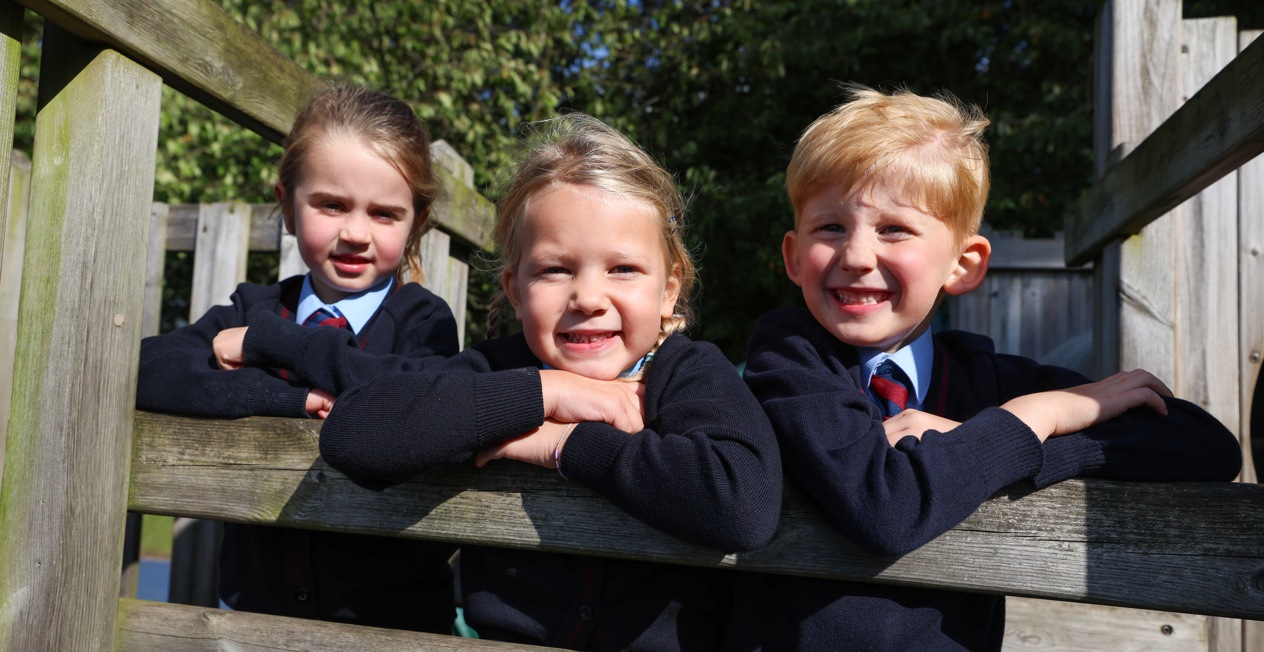
EYFS Level 3 Teaching Assistant
St Joseph’s Catholic Academy, Norton
EYFS Level 3 Teaching Assistant
Band H, SCP 14 32.5 hours per week Term Time Only - temporary until 31st August 2025
£21,164 - £21,644 pro rata
(FTE £28,624)
Closing Date:9am Wednesday 11th December 2024
Provisional Interview date: Friday 13th December 2024
Mr A McGeeney, Headteacher St Joseph’s Catholic Academy, Ragworth Road, Norton, Stockton on Tees
TS20 1HR
St Joseph’s Catholic Academy wish to appoint a temporary EYFS Level 3 Teaching Assistant to start in January 2025.
The successful candidate will be reliable, flexible and enthusiastic, working under the direction of the Headteacher.
All applicants should be willing to support the Catholic ethos and values of the school.
Successful candidates will be able to:
• Establish productive working relationships with pupils, acting as a role model and setting high expectations.
• Support pupils consistently whilst recognising and responding to their individual needs.
• Encourage pupils to interact and work cooperatively with others and engage all pupils in activities.
• Promote independence and employ strategies to recognise and reward achievement of self- reliance;
• Provide effective support to the Teachers across the school.
We can offer you:
• A committed and hardworking staff team
• A well-resourced school
• Well behaved, happy children
We welcome school visits, please contact the school office to arrange a suitable time on 01642 360 401 or email office@stjosephsnorton.bhcet.org.uk
For full details on how to apply please visit our website stjosephsnorton.bhcet.org.uk where you are able to download an application form and supporting documents. Applications should be returned to recruitment@stjosephsnorton.bhcet.org.uk by the closing date Wednesday 11th December 2024 at 9am.
Bishop Hogarth Catholic Education Trust is committed to safeguarding and promoting the welfare of children and young people and expects all staff and volunteers to share this commitment. This post will be subject to a satisfactory Enhanced Disclosure and Barring Service check. The school will consider carrying out an online search as part of the due diligence on shortlisted candidates. As an employee of Bishop Hogarth Catholic Education Trust you may work from time to time in one or more of our Academies.

