Slide 1
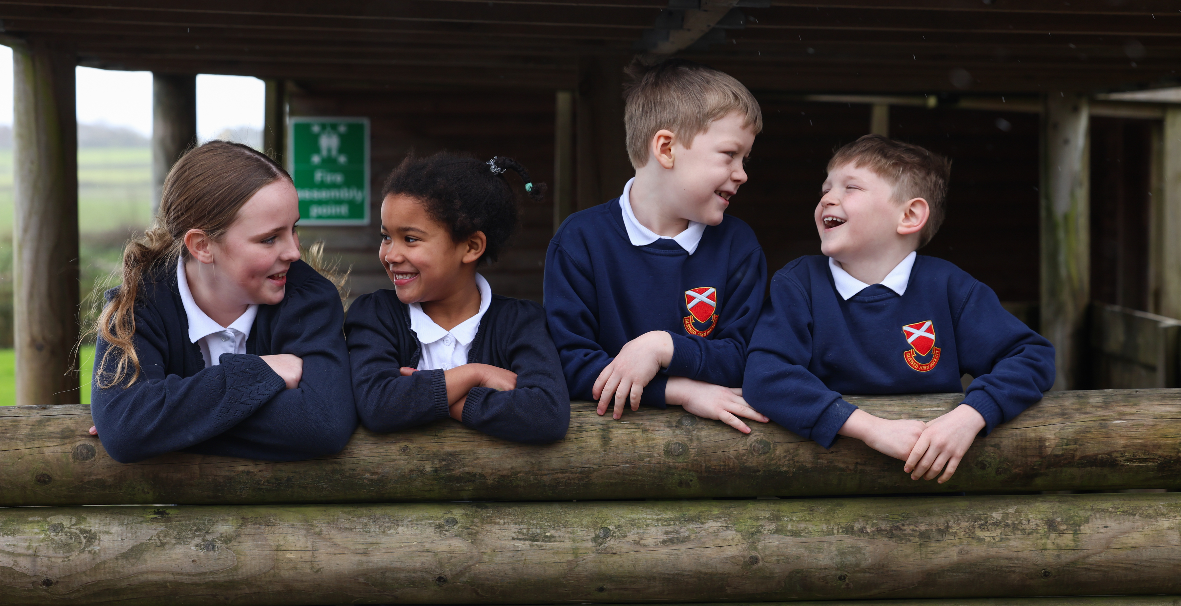
Key Stage Two Teacher
Key Stage Two Teacher
Main Pay Scale
A1 – B6
£30,000 - £41,333
Full time
Fixed Term until 31st August 2025
Permanent: To start as soon as possible
Closing Date: Friday 11th October 2024 at 9.00am
The Directors of Bishop Hogarth Catholic Education Trust and Governors of Blessed John Duckett are seeking to appoint an excellent Key Stage Two classroom teacher.
We are looking to appoint a skilled, committed, enthusiastic and inspirational teacher to join our friendly, successful team. We seek someone who:
Is committed to supporting the Catholic ethos of the school.
Is passionate about pupil learning.
Has a commitment to outstanding teaching and learning and delivering interesting and inspiring lessons.
A good communicator; working to build and maintain positive relationships with our families.
Creative, forward thinking, and able to work as part of a team as well as using their own initiative to ensure quality education for all pupils.
We can offer:
A school that is passionate and committed to improving the life chances of children.
A caring, successful school with friendly, hardworking colleagues.
Happy, well behaved, and enthusiastic children.
Supportive governors who take an active interest in supporting and challenging the school.
A commitment to your professional development.
Further details and application forms are available online on
the Trust website: https://bhcet.org.uk/vacancies
If you would like more information on the post or wish to
visit the school, please call 01388 731082 or email jellison@blessedjohnduckett.bhcet.org.uk
Completed application forms to be emailed to office@blessedjohnduckett.bhcet.org.uk or posted to Miss J. Ellison, Blessed John Duckett, Smith Street, Tow Law, Co. Durham, DL13 4AU.
Bishop Hogarth Catholic Education Trust is committed to safeguarding and promoting the welfare of children and young people and expects all staff and volunteers to share this commitment. This post will be subject to a satisfactory Enhanced Disclosure and Barring Service check. The school will consider carrying out an online search as part of the due diligence on shortlisted candidates. As an employee of Bishop Hogarth Catholic Education Trust you may work from time to time in one or more of our Academies.

